Slide 1
REST - Representational State Transfer

Slide 2
What is REST ?
REST is a term coined by Roy Fielding to describe an architecture style of networked systems. REST is an acronym standing for Representational State Transfer.

Slide 3
Rest – An architectural Style
Elements
Components – Proxy , gateway etc
Connectors – client , server etc
Data – resource , representation etc
REST
Ignores component implementation details.
Focus on roles of components,their interactions and their
interpretation of data elements.

Slide 4
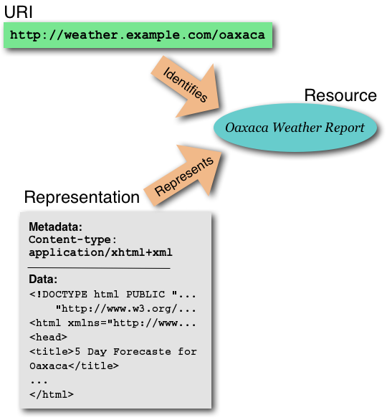
Resource
URI-Uniform Resource Identifier (or URL)
Web Page (HTML Page)

Slide 5
Why is it called Representational State Transfer ?
Client
http://weather.example.com/oaxaca
Resource
OaxacaWeather.html

Slide 6
"Representational State Transfer is intended to evoke an image of how a well-designed Web application behaves: a network of web pages (a virtual state-machine), where the user progresses through an application by selecting links (state transitions), resulting in the next page (representing the next state of the application) being transferred to the user and rendered for their use."
Roy Fielding.

Slide 7
REST - An Architectural Style of Networked System
Underlying Architectural model of the world wide web.
Guiding framework for Web protocol standards.
REST based web services
Online shopping
Search services
Dictionary services

Slide 8
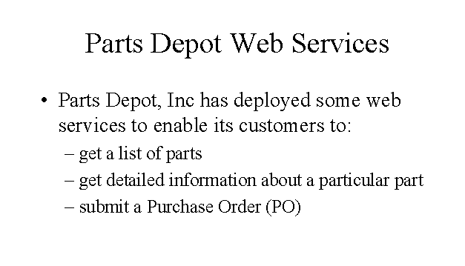

Slide 9
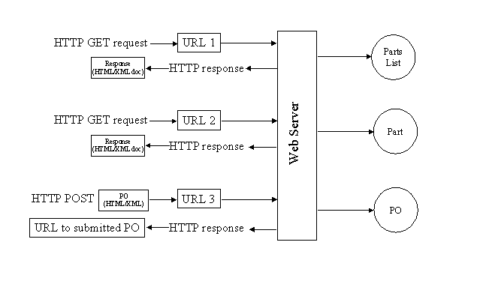
REST way of Implementing the web services

Slide 10
Service – Get parts list
The web service makes available a URL to a parts list resource
Client uses : http://www.parts-depot.com/parts
Document Client receives :
<?xml version="1.0"?>
<p:Parts xmlns:p="http://www.parts-depot.com" xmlns:xlink="http://www.w3.org/1999/xlink">
<Part id="00345" xlink:href="http://www.parts-depot.com/parts/00345"/>
<Part id="00346" xlink:href="http://www.parts-depot.com/parts/00346"/>
<Part id="00347" xlink:href="http://www.parts-depot.com/parts/00347"/>
<Part id="00348" xlink:href="http://www.parts-depot.com/parts/00348"/>
</p:Parts>

Slide 11
Service – Get detailed part data
The web service makes available a URL to each part resource.
Client uses : http://www.parts-depot.com/parts/00345
Document Client receives :
<?xml version="1.0"?>
<p:Part xmlns:p="http://www.parts-depot.com" xmlns:xlink="http://www.w3.org/1999/xlink">
<Part-ID>00345</Part-ID>
<Name>Widget-A</Name>
<Description>This part is used within the frap assembly</Description>
<Specification xlink:href="http://www.parts-depot.com/parts/00345/specification"/> <UnitCost currency="USD">0.10</UnitCost>
<Quantity>10</Quantity>
</p:Part>

Slide 12
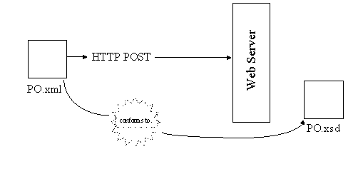
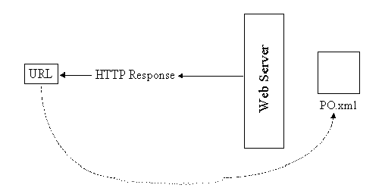
Service – Submit purchase order (PO)
The web service makes
available a URL to submit a PO.
1)The client creates a PO instance
document (PO.xml)
2)Submits the PO.xml(HTTP POST)
3)PO service reponds with a URL
to the submitted PO.

Slide 13
Characteristics of a REST based network
Client-Server: a pull-based interaction style(Client request data from servers as and when needed).
Stateless: each request from client to server must contain all the information necessary to understand the request, and cannot take advantage of any stored context on the server.
Cache: to improve network efficiency, responses must be capable of being labeled as cacheable or non-cacheable.
Uniform interface: all resources are accessed with a generic interface (e.g., HTTP GET, POST, PUT, DELETE).
Named resources - the system is comprised of resources which are named using a URL.
Interconnected resource representations - the representations of the resources are interconnected using URLs, thereby enabling a client to progress from one state to another.

Slide 14
Principles of REST web service design
1.Identify all the conceptual entities that we wish to expose as services. (Examples we saw include resources such as : parts list, detailed part data, purchase order)
2. Create a URL to each resource.
3. Categorize our resources according to whether clients can just receive a representation of the resource (using an HTTP GET), or whether clients can modify (add to) the resource using HTTP POST, PUT, and/or DELETE).
4. All resources accessible via HTTP GET should be side-effect free. That is, the resource should just return a representation of the resource. Invoking the resource should not result in modifying the resource.
5.Put hyperlinks within resource representations to enable clients to drill down for more information, and/or to obtain related information.
6. Design to reveal data gradually. Don't reveal everything in a single response document. Provide hyperlinks to obtain more details.
7. Specify the format of response data using a schema (DTD, W3C Schema, RelaxNG, or Schematron). For those services that require a POST or PUT to it, also provide a schema to specify the format of the response.
8. Describe how our services are to be invoked using either a WSDL document, or simply an HTML document.

Slide 15
Summary
REST – Is an architectural style.
It is the architectural style of the WEB
Resource
http://www.ics.uci.edu/~fielding/pubs/dissertation/rest_arch_style.htm

